Slide 1
Lecture 6 Drivers, Timers, Debugging, Lab #5
Assignment and References
Device Drivers – Levels 0, 1, 2
Timers: Cortex-A9 Processor
Private Timers
Scutimer_v2_0 driver
C:\Xilinx\SDK\2014.4\data\embeddedsw\XilinxProcessorIPLib\drivers\scutimer_v2_0
Lab #5 Explained: ARM timer
XMD/GDB Debug
System Debugger/TCF

Slide 2
Assignment and References
Lab #5 Private Timer and Debugging
ZYNQ Lab 5 Software Writing for Timer and Debugger, pages ZYNQ5-1 to ZYNQ5-11.
Lab #6 LED Ping Pong Game on Zybo with Polling
Xilinx: Zynq-7000 All Programmable SoC, Technical Reference Manual, UG585 (v1.10) February 23, 2015
Altera: SoC FPGA ARM Cortex-A9 MPCore Processor Advance Information Brief, aib-01020, February 2012 Altera Corporation
Altera: Cyclone V Device Handbook, Volume 3: Hard Processor System Technical Reference Manual, November 2012 Altera Corporation
Xilinx Processor IP Library – scutimer v2_0 C:\Xilinx\SDK\2014.4\data\embeddedsw\XilinxProcessorIPLib\drivers\scutimer_v2_0

Slide 3
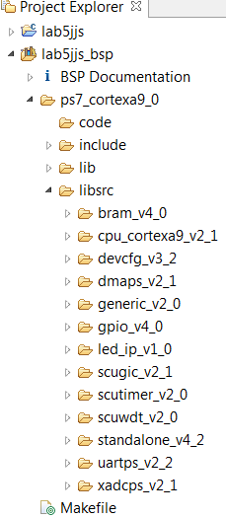
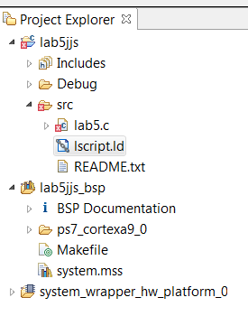
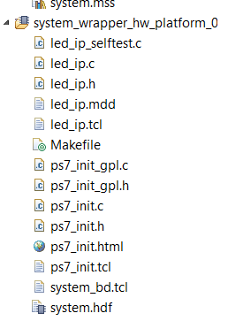
SDK Project: Source files, Linker Script, BSP, Hardware Platform
Software Project
Source code
Linker script file
Board Support Package *.bsp (Drivers)
Hardware Platform – system_wrapper

Slide 4
Device Drivers (Hardware Drivers and Software Drivers)
The Xilinx device drivers are designed to meet the following objectives
Provide maximum portability
The device drivers are provided as ANSI C source code
Support FPGA configurability
Supports multiple instances of the device without code duplication for each instance, while at the same time managing unique characteristics on a per-instance basis
Support simple and complex use cases
A layered device driver architecture provides both
Simple device drivers with minimal memory footprints
Full-featured device drivers with larger memory footprints
Ease of use and maintenance
Xilinx uses coding standards and provides well-documented source code for developers

Slide 5
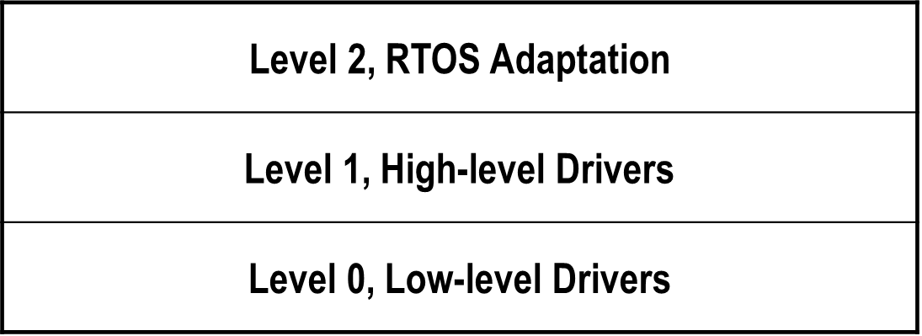
Software Drivers: Level 0 and Level 1
The layered architecture provides seamless integration with…
(Level 2) RTOS application layer
(Level 1) High-level device drivers that are full-featured and portable across operating systems and processors
(Level 0) Low-level drivers for simple use cases

Slide 6
Software Drivers: Level 0
Consists of low-level device drivers
Implemented as macros and functions that are designed to allow a developer to create a small system
Characteristics:
Small memory footprint
Little to no error checking is performed
Supports primary device features only
No support of device configuration parameters
Supports multiple instances of a device with base address input to the API
Polled I/O only
Blocking function calls

Slide 7
Software Drivers: Level 1
Consists of high-level device drivers
Implemented as macros and functions and designed to allow a developer to utilize all of the features of a device
Characteristics:
Abstract API that isolates the API from hardware device changes
Supports device configuration parameters
Supports multiple instances of a device
Polled and interrupt driven I/O
Non-blocking function calls to aid complex applications
May have a large memory footprint
Typically, provides buffer interfaces for data transfers as opposed to byte interfaces

Slide 8
Level 1 and Level 0 Driver Examples: uart drivers
UARTPS Level 1
XUartPs_CfgInitialize() - Initializes a specific XUartPs instance such that it is ready to be used
XUartPs_Send() - Sends the specified buffer using the device in either polled or interrupt driven mode.
XUartPs_Recv() - Receive a specified number of bytes of data from the device and store it into the specified buffer.
XUartPs_SetBaudRate() - Sets the baud rate for the device.
UARTPS Level 0
XUartPs_SendByte()- Sends one byte using the device.
XUartPs_RecvByte()- Receives a byte from the device.

Slide 9
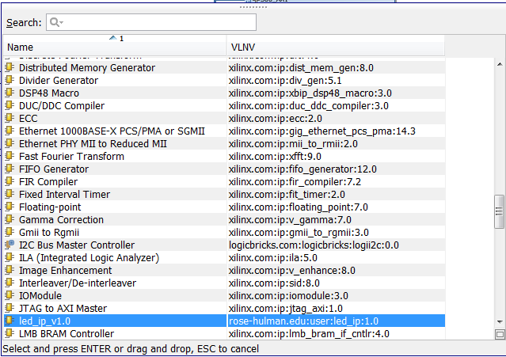
Hardware Device Drivers Are also Called IP Components
Under Manage IP->IP Integrator, click Add IP icon
Hardware IP components can also be called hardware design drivers
IP components can be added to a circuit design

Slide 10
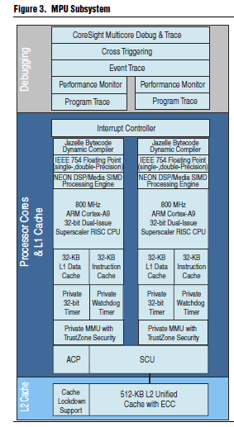
ARM Cortex-A9 MPU
two Cortex-A9 processor cores,
the level 2 (L2) cache and memory
Subsystem
Snoop Control Unit (SCU)
Accelerator Coherency Port (ACP)
Debug functions
Altera: SoC FPGA ARM Cortex-A9 MPCore Processor Advance Information Brief, aib-01020

Slide 11
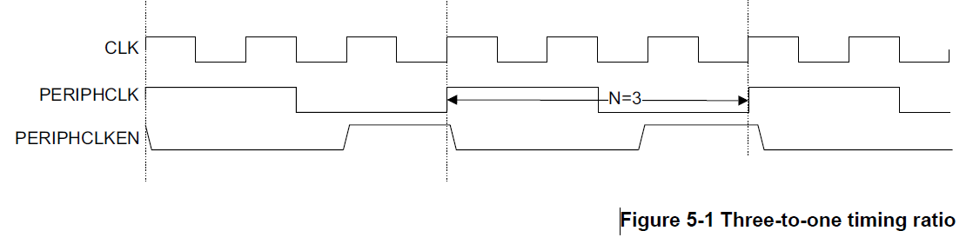
Clock, Peripheral Clock, peripheral Clock Enable
CLK – System Clock Frequency, fixed frequency
All Cortex-A9 processors in the Cortex-A9 MPCore processor and the SCU are clocked with a distributed version of CLK.
Zybo CLK is 650MHz
PERPHCLK – Peripheral clock frequency, ½ of CLK speed
The Interrupt Controller, global timer, private timers, and watchdogs are clocked with PERIPHCLK.
PERIPHCLKEN
This is the clock enable signal for the Interrupt Controller and timers. The PERIPHCLKEN signal is generated at CLK clock speed. PERIPHCLKEN HIGH on a CLK rising edge indicates that there is a corresponding PERIPHCLK rising edge.
Cortex-A9 MPCore TRM DDI0407F_c

Slide 12
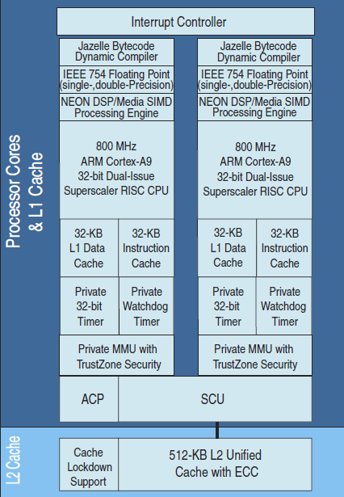
Timers of Cortex-A9 Processor
Each CPU has one 32-bit private timer and 32-bit watchdog timer, accessible only by this CPU
8-bit Prescaler
Single-shot or auto-reload modes
Optional interrupt
Both CPUs share a 64-bit global timer (GTC)
Each CPU has a private 64-bit compare module to generate private interrupts on compare
All are Clocked at ½ CPU clock and count down timers
Altera: SoC FPGA ARM Cortex-A9 MPCore Processor Advance Information Brief, aib-01020

Slide 13
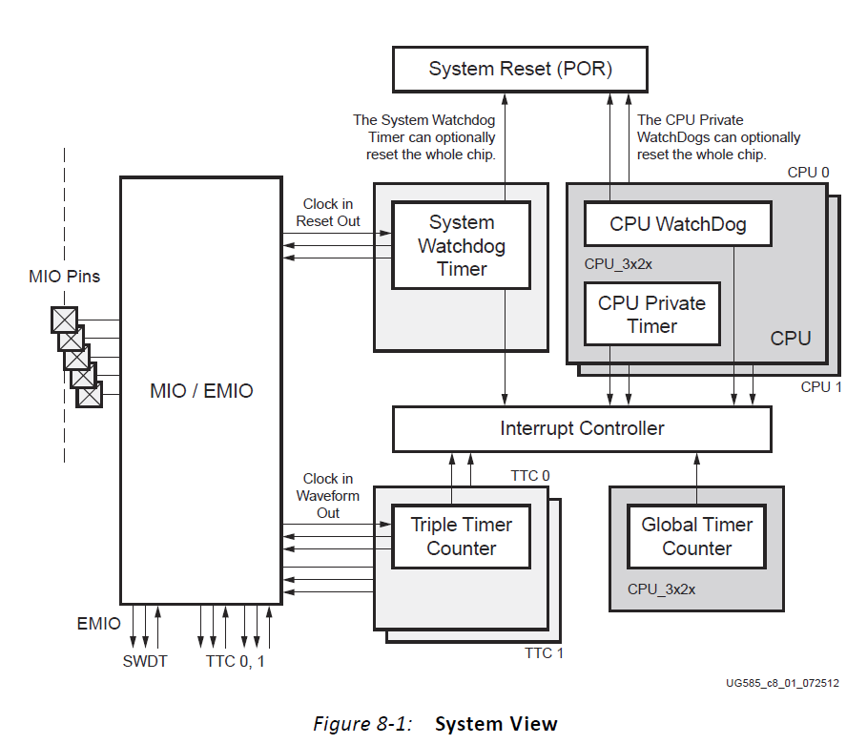
Timers of Cortex-A9 Processor
Xilinx: Zynq-7000 All Programmable SoC, Technical Reference Manual, UG585 (v1.10) February 23, 2015

Slide 14
32-bit Private Count-Down Timers of Cortex-A9 Processor
Each CPU has one 32-bit private timer and 32-bit watchdog timer, accessible only by this CPU
8-bit Prescaler
Single-shot or auto-reload modes
Optional interrupt
By default 32-bit count down timer
Both CPUs share a 64-bit global timer (GTC)
Each CPU has a private 64-bit compare module to generate private interrupts on compare
Clocked at ½ CPU clock
Xilinx: Zynq-7000 All Programmable SoC, Technical Reference Manual, UG585 (v1.10) February 23, 2015

Slide 15
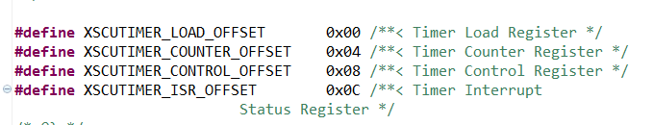
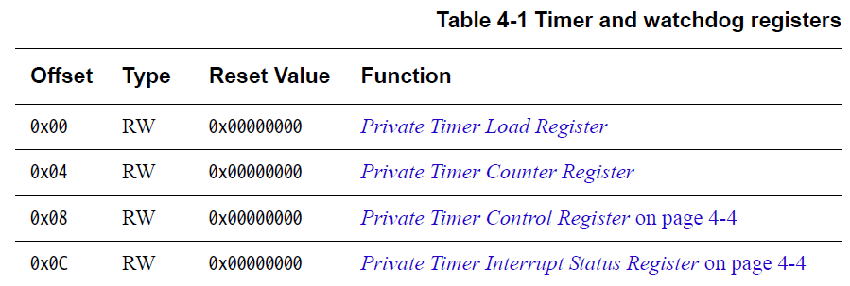
Four 32-bit Timer Registers (xscutimer_hw.h)
Load Register
Counter Register
Control Register
Status Register
Defined in xscutimer_hw.h
Xilinx: Zynq-7000 All Programmable SoC, Technical Reference Manual, UG585 (v1.10) February 23, 2015

Slide 16
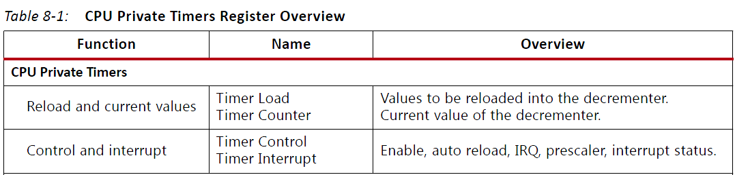
32-Bit Load Register and Counter Register
Private Timer Load Register
The Timer Load Register contains the value copied to the Timer Counter Register when it decrements down to zero with auto reload mode enabled. Writing to the Timer Load Register means that you also write to the Timer Counter Register.
Private Timer Counter Register
The Timer Counter Register is a decrementing counter. It decrements if the timer is enabled using the timer enable bit in the Timer Control Register. When the Timer Counter Register reaches zero and auto reload mode is enabled, it reloads the value in the Timer Load Register and then decrements from that value. If auto reload mode is not enabled, the Timer Counter Register decrements down to zero and stops.
Cortex-A9 MPCore TRM DDI0407F_c

Slide 17
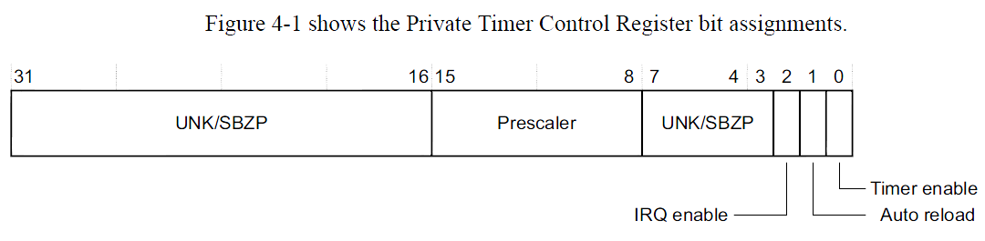
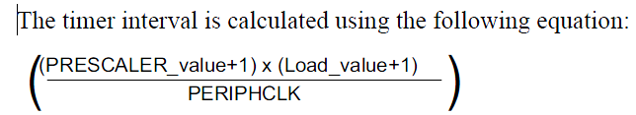
8-Bit Prescaler, IRQ Enable Bit
The 8-Bit Prescaler
modifies the clock period for the decrementing event for the Counter Register.
Timer clock period = Prescaler/PERPHCLK=Prescaler/(2*CLK)
IRQ Enable Bit
If set, the interrupt ID 29 is set as pending in the Interrupt Distributor when the event flag is set in the Timer Status Register.
Cortex-A9 MPCore TRM DDI0407F_c

Slide 18
Auto Reload, Timer Enable, Clock of 32-bit Private Timers
Auto Reload Bit
1'b0 = Single shot mode. Counter decrements down to zero, sets the event flag and stops.
1'b1 = Auto-reload mode. Each time the Counter Register reaches zero, it is reloaded with the value contained in the Timer Load Register.
Timer Enable Bit
1'b0 = Timer is disabled and the counter does not decrement.
All registers can still be read and written
1'b1 = Timer is enabled and the counter decrements normally.
The timer is decremented every prescaler value+1.
For example, if the prescaler has a value of five then the global timer is decremented every six clock cycles. PERIPHCLK is the reference clock for this.
Cortex-A9 MPCore TRM DDI0407F_c

Slide 19
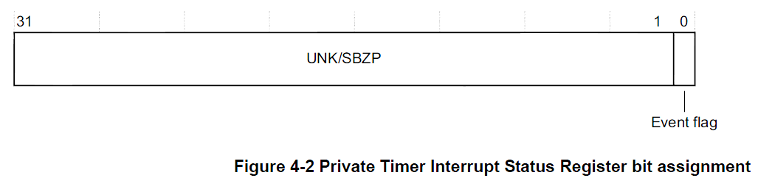
Private Timer Interrupt Status Register – Event Flag
The event flag is a sticky bit that is automatically set when the Counter Register reaches zero.
If the timer interrupt is enabled, Interrupt ID 29 is set as pending in the Interrupt Distributor after the event flag is set.
The event flag is cleared when written to 1.
Cortex-A9 MPCore TRM DDI0407F_c

Slide 20
Private Timer Interrupt Status Register – Event Flag
The event flag is a sticky bit that is automatically set when the Counter Register reaches zero.
If the timer interrupt is enabled, Interrupt ID 29 is set as pending in the Interrupt Distributor after the event flag is set.
The event flag is cleared when written to 1.
Cortex-A9 MPCore TRM DDI0407F_c

Slide 21
Level 1 Software Drivers for Private Timers: scutimer v2_0
C:\Xilinx\SDK\2014.4\data\embeddedsw\XilinxProcessorIPLib\drivers\scutimer_v2_0
The timer driver supports the Cortex A9 private timer
The timer driver supports the following features:
Normal mode and Auto reload mode
Interrupts (Interrupt handler is not provided in this driver. Application has to register it's own handler)
Header files:
xscutimer.h software definition header file
Xscutimer_hw.h hardware definition header file
Initialization and Configuration
The device driver enables higher layer software (e.g., an application) to communicate with the Timer.
XScuTimer_CfgInitialize() API is used to initialize the Timer.
The user needs to first call theXScuTimer_LookupConfig() API which returns the Configuration structure pointer which is passed as a parameter to the XScuTimer_CfgInitialize() API.

Slide 22
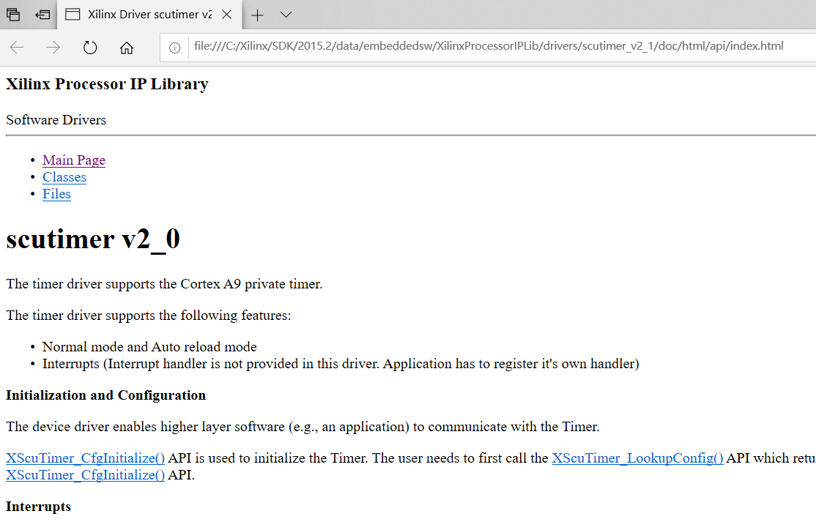
Level 1 Software Drivers for Private Timers: scutimer v2_0
File: //C:/Xilinx/SDK/2015.2/data/embeddedsw/XilinxProcessorIPLib/drivers/scutimer_v2_1/doc/html/api/index.html

Slide 23
Level 1 Software Drivers for Private Timer/Counter (Standalone)
xscutimer.h software definition header file
Xscutimer_hw.h hardware definition header file
XScuTimer_LookupConfig() - Looks up the device configuration based on the unique device ID
XScuTimer_CfgInitialize() - Initialize a specific XTtcPs instance such that the driver is ready to use
XscuTimer_SetPrescaler() – Set the pre-scalar value between 1 and 255
XScuTimer_LoadTimer() – Load the timer with the provided value
XScuTimer_EnableAutoReload() – Load the counter with the initial value when time out occurs
XScuTimer_ClearInterruptStatus() – Clear source of interrupt flag
XScuTimer_Start() – Start the timer
XScuTimer_Stop() – Stop the timer
XScuTimer_GetPrescaler() – Get the pre-scalar value

Slide 24
Level 1 Software Drivers for Private Timer/Counter (Standalone)
XScuTimer_IsExpired() – Check if the timer has reached the final value
XScuTimer_RestartTimer() – Read the counter value and write it back
XScuTimer_GetCounterValue() – Get current counter value; useful for determining lapse time
XScuTimer_EnableInterrupt() – Enable interrupt mechanism
XScuTimer_GetInterruptStatus() – Get the interrupt status

Slide 25
Level 0 Software Drivers for Private Timer/Counter (Standalone)
XScuTimer_WriteReg() –
XScuTimer_ReadReg() –

Slide 26
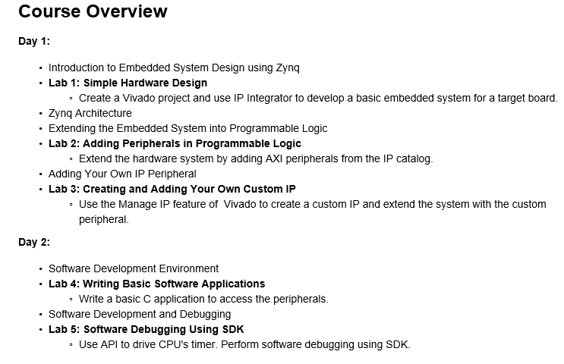
Lab #5: Software Writing for Timer and Debugging
Based on Lab 5 Software Writing for Timer and Debugging of Embedded System Design Flow on Zynq using Vivado” from the Xilinx University Program (XUP) Website: 2014x Workshop Material.

Slide 27
Lab #5: Timer Setup Statements
XScuTimer Timer;/* Cortex A9 SCU Private Timer Instance */
// PS Timer related definitions
XScuTimer_Config *ConfigPtr;
XScuTimer *TimerInstancePtr = &Timer;
// Initialize the timer
ConfigPtr= XScuTimer_LookupConfig(XPAR_PS7_SCUTIMER_0_DEVICE_ID);
Status=XScuTimer_CfgInitialize(TimerInstancePtr,ConfigPtr, XPAR_PS7_SCUTIMER_0_BASEADDR);
if(Status!=XST_SUCCESS) { xil_printf("Timer failed\r\n");
return XST_FAILURE; }
// Load timer with delay in multiple of ONE_TENTH
XScuTimer_LoadTimer(&Timer, dip_check_prev*ONE_TENTH);
// Set AutoLoad mode
XScuTimer_EnableAutoReload(&Timer);
// Start the timer
XScuTimer_Start(&Timer);

Slide 28
Lab #5: struct XScuTimer_Config and XScuTimer in xscu_timer.h
struct XScuTimer_Config – define timer configuration
struct XScuTimer – define one instance of Timer
typedef struct {
u16 DeviceId; /**< Unique ID of device */
u32 BaseAddr; /**< Base address of the device */
} XScuTimer_Config;
typedef struct {
XScuTimer_Config Config; /**< Hardware Configuration */
u32 IsReady; /**< Device is initialized and ready */
u32 IsStarted; /**< Device timer is running */
} XScuTimer;

Slide 29
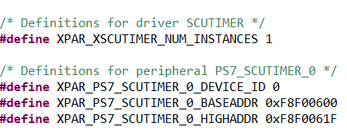
Lab #5: Define a Timer: Find Device ID, Configure Timer
XScuTimer_LookupConfig(XPAR_PS7_SCUTIMER_0_DEVICE_ID);
XScuTimer_Config *XScuTimer_LookupConfig(u16 DeviceId);
Device ID is defined in xparameters.h
XScuTimer_CfgInitialize(Timer, ConfigPtr, ConfigPtr->BaseAddr);
defined in xscutimer.c
int XScuTimer_CfgInitialize(XScuTimer *InstancePtr, XScuTimer_Config *ConfigPtr, u32 EffectiveAddress)
Initialize a specific timer instance/driver. This function must be called before other functions of the driver are called.
EffectiveAddress is the base address for the device
ConfigPtr->BaseAddr
To point to a member of a struct by a pointer, use ->

Slide 30

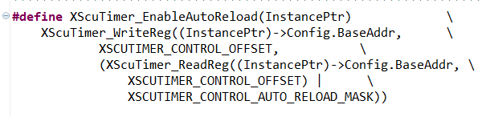
Lab #5: Load Initial Value, Enable Auto Reload, and Start Timer
XScuTimer_LoadTimer(&Timer, 32500000); //assume Prescaler=0
Define in xscutimer.h
To write value 32500000 into Load Register
Timer Delay Time = 32500000/(650MHz/2)=0.1 s =100 ms
XScuTimer_EnableAutoReload(&Timer);
Define in xscutimer.h to Enable auto-reload mode.
XScuTimer_Start(&Timer);

Slide 31
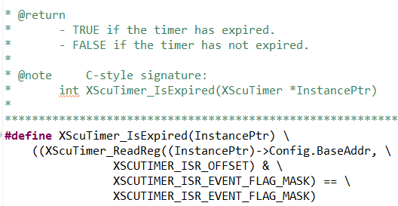

Lab #5: Check Status, Clear Status -> Event Flag
XScuTimer_IsExpired(&Timer);
Defined in xscutimer.h
TRUE when the timer has expired, i.e., Event Flag=1
XScuTimer_ClearInterruptStatus(&Timer);
This function clears the interrupt status.

Slide 32
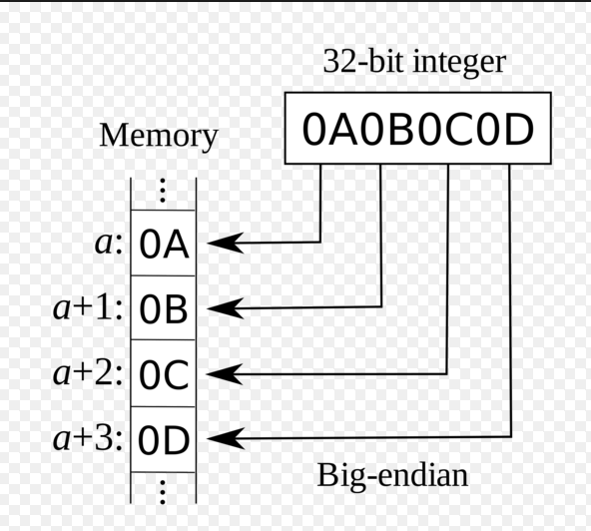
Lab #5: Little Endian and Big Endian (Lab #5 on Page Zynq 5-9)
BIG-ENDIAN
The most significant byte of a word is stored at a memory location at one address and the subsequent bytes are stored in the following higher memory addresses, the least significant byte thus being stored at the highest memory address.
LITTLE-ENDIAN
Opposite of Big-Endian in that the least significant byte is stored at the lowest memory address with the most significant byte being stored at the highest memory address.
https://en.wikipedia.org/wiki/Endianness

Slide 33
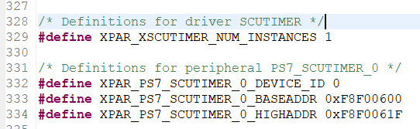
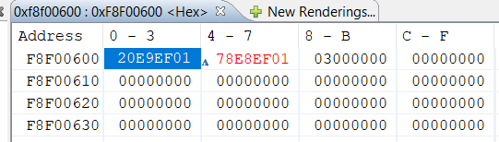
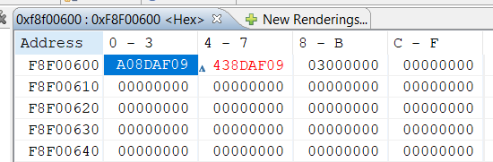
Lab #5: Little Endian and Big Endian (Lab #5 on Page Zynq 5-9)
Load=0x09AF8DA0
=162,500,000
=5x32,500,000
Load=0x01EFE920
=32,500,000

Slide 34
Level 0 Software Drivers for Private Timers in xscutimer_hw.h
XScuTimer_ReadReg(BaseAddr, XSCUTIMER_LOAD_OFFSET);
XScuTimer_WriteReg(BaseAddr, XSCUTIMER_COUNTER_OFFSET, Value);
These are not found anywhere in the project???

Slide 35
Software Debugging Support
Vivado/SDK supports software debugging through
GDB tools
Unified graphical interface for debugging and verifying processing systems
Xilinx Microprocessor Debugger (XMD)
Runs all the hardware debugging tools and communicates with the hardware
Shell for hardware communication
Tool command language (Tcl) syntax and command interpreter
GNU tools communicate with the hardware through XMD
Xilinx System Debugger, Eclipse Target Communications Framework (TCF)

Slide 36
Hardware Debugging Support
Vivado supports hardware debugging via the following tools
Vivado Logic Analyzer software
Soft-core base logic analyzer
Operates through a Xilinx download cable
Zynq™ AP SoC virtual platform
Functional simulation of physical hardware for the purpose of software development, integration, and test
Runs on the desktop
Facilitates early software development and test
Zynq AP SoC open-source QEMU model
Open-source machine emulator and virtualizer for Linux environment

Slide 37
XMD Debugger
The Xilinx Microprocessor Debug (XMD) utility provides a variety of user debug services
Physical connection between your workstation and the software design
Connection to an internal BSCAN controller
Program download
Processor identification and control
Low-level debug commands
Interface to the GNU debugger
General Tcl interface and command interpreter
Program download

Slide 38
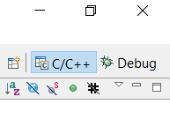
XMD Debugger
For debugging standalone or bare-metal applications, serves as gdbserver for gdb and SDK
For Linux applications, SDK interacts with a gdbserver running on the target
XMD is started via the Xilinx Tools > Program FPGA command in SDK
XMD is essentially launched and controlled via the RUN menu
To switch between Debugging mode and project manager mode, click on C/C++ or Debug at the upper right corner of SDK.

Slide 39
XMD Functionality
XMD engine
Program that facilitates a unified GDB interface
Tcl interface and command interpreter
XMD supports application debugging on different targets
GDB/TCF can connect to XMD on the same computer or on a remote computer on the Internet

Slide 40
XMD Commands
There are many XMD commands
Popular commands for boot and program control
connect – connect to processor
dow – download ELF executable file
elf_verify – verify ELF file with memory image
run – begin program execution from reset
con – continue program execution from current program counter
stop – stop the target processor
exit – close XMD window
XMD will search for a processor when started and launched from the SDK Run > Debug menu
connect command will execute automatically
connect arm 64

